Slide 1
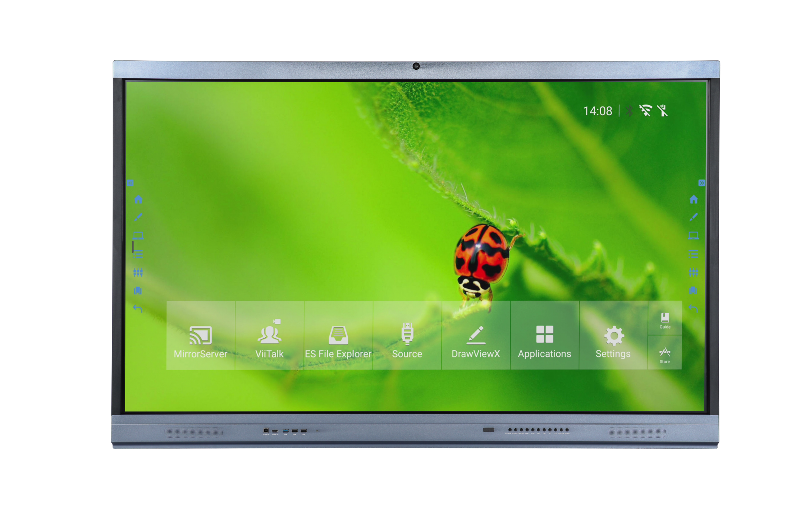
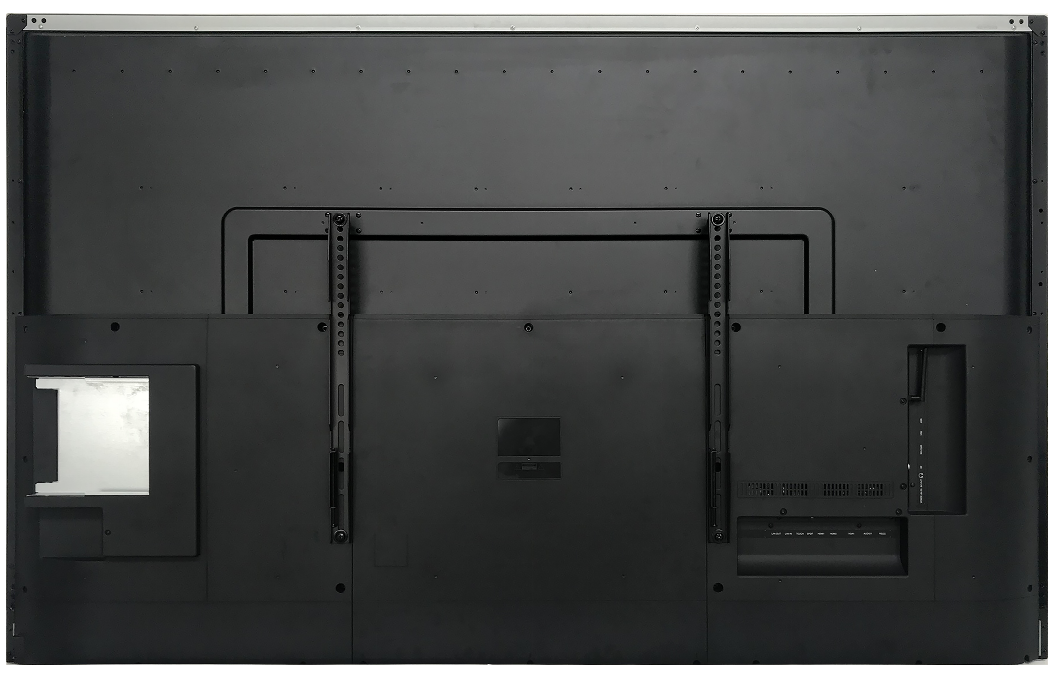
NCTS B Series
Multi-Touch Screen Monitor
New generation Intelligent Multi-Touch Meeting Monitor
Honored:
Newly designed model，with built in camera and MIC, good outlooking and wide view angle，bring a different new visual experience for presentation.
Fast and high accuracy infrared Multi-touch，smooth writing and convenient finger-guesture erasing
Built-in HD remote-distance meeting system, support up to 4 remote meeting devices to join meeting
Support scan QR code of the whiteboard software to share the meeting records by mobile devices.
Remote Online
Video Meeting System(Optional)
Wireless Projection
Wireless Multi-Screens Sharing Funciton
Cloud Conference
Writing Annotation
Sharing or Saving by Scanning QR Code
Product View
Front View
Back View

Slide 2
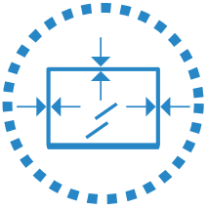
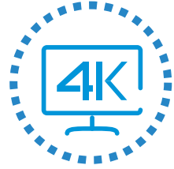
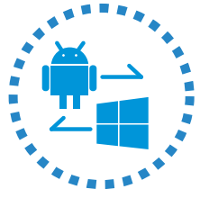
Product Feactures
Built in Camera and MIC
With built in FHD camera and mircrophone, it is convenient to start a face to face meeting or conversation easily.
Multi-Touch
Leading infrared sensing positioning technology, support multi-person writing at same time, support writting by your fingers or any opaque object, Intelligent gesture recognition, can meet various meeting demands.
UHD 4K Resolution
4K picture quality, more delicated. High-precision UHD picture for visual enjoyment. Support mobile wireless control, built-in annotation applications and other software.
All-in-One Design
Six functions in one, integrate functions of projector, interactive board, computer, television, koisk and audio but better user experience. It is an ideal solution for business presentation or schools.
Dual System Supporting
Support Android and Windows dual system, each system can be operated and managed separately, elegant simplified UI interface for Android, can select the required functions quickly,configured with DrawView X annotation software, can quickly write down handwriting with real writing feeling.
Annotation
The built-in Android Annotation software can mark notes or contents on the Android interface or on any opened files on the Windows system. You can highlight or mark over the documents or video no matter in Android or windows system.

Slide 3
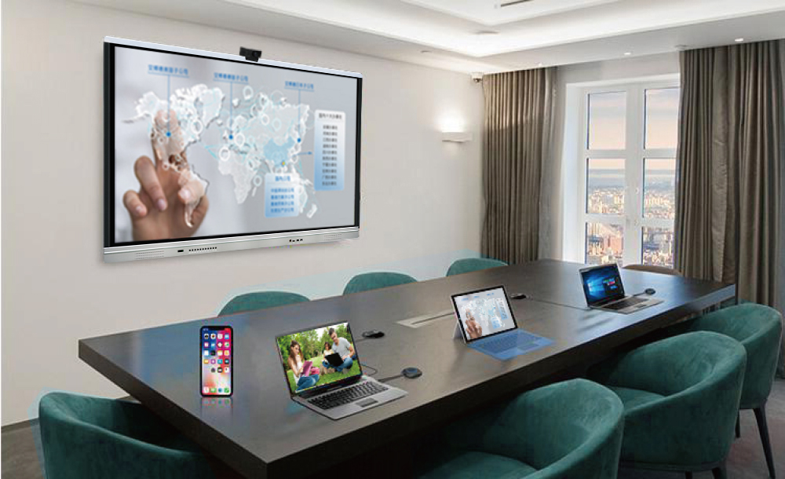
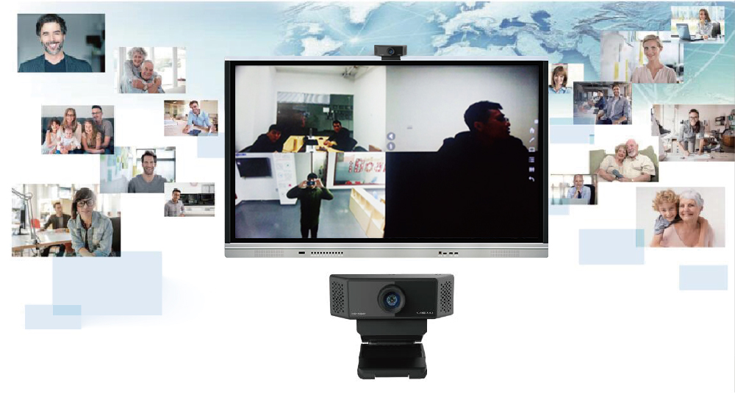
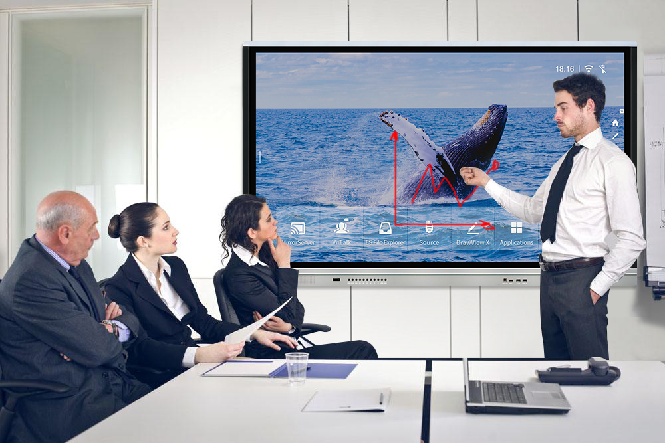
Advantage Functions
Screen Sharing System, Multi-Screen Interactivity
Scene 1: Connect touch monitor's hotspot wirelessly for screen projection
Connect the touch monitor's hotspot
When use computer or Android mobile phone for screen projection, refer to the guide of the screen sharing system to download the screen-sharing apllication
Select the current touch screen's hotspot to make a smooth multi-screen projection
Scene 2: use 2.4G wireless connection or external wired connected router for screen projection
Please connect your Android phone or computer and the receiving device to the same router.
When use computer or Android mobile phone for screen projection, refer to the guide of the screen sharing system to download the screen-sharing apllication
Select the current touch screen's hotspot to make a smooth multi-screen projection
Video Conferencing System (Optional)
Remote-distance teleconferencing software
Cloud conference service
Site to site, multi-parties online video meeting system
Suggested to use a broadband network with an uplink speed >100kb/s for starting the online video meeting
Configured with an high-definition FHD camera(optional), enable a more delicated and smooth video to conduce
Video conference camera needs to be purchased separately
Video conference multi-parties online meeting call need to pay relevant call fees according to the operator's standard
Simple and Convenient Operation
Annotations can be made in any interface; Annotations can be saved on the page at PPT mode.
Spotlight and other small tools in the Annotation software can assist meeting presentation and demonstration
Meeting records can be easily and conveniently shared by scanning QR code or email,this will make meeting records sharing fast and convenient

Slide 4
Specification
Model | NCTS-TMB65 | NCTS-TMB75 |  | NCTS-TMB86
Dispaly Backlight | D-LED Backlight
Resolution | 3840*2160 | 3840*2160 |  | 3840*2160
Brightness | 350 cd/㎡ | 350 cd/㎡ |  | 350 cd/㎡
Contrast | 1200:1 | 1200:1 |  | 1200:1
Screen Size(mm) | 1428.5*803.5 | 1649.7*927.9 |  | 1895.04*1065.96
Aspect Ratio | 16:9
View Angle | 178°
Screen Mode | 16:9/4:3/dot to dot/full screen
Color Depth | 10bit, 1.07Billon colors | 10bit, 1.07Billon colors |  | 10bit, 1.07Billon colors
Panel Response Time | 8ms | 8ms |  | 8ms
Suport Resolution | 1280*960/1280*1024/1360*768/1440*900/1600*1200/1920*1080/3840*2160@60HZ
Android Specification | Android 8.0
 | 2 x ARM Cortex-A73@1.5GHz 2 x ARM Cortex-A53@1.5GHz
 | ARM Mali-G51450MHz
 | Ram: 4G
 | Storage: 32G
Input Ports | Back: HDMI2.0*2, DP*1, VGA-IN*1, VGA Audio-input*1, YPBPR*1, AV-in*1, RS232 Series*1,USB3.0*1, USB2.0*1 , RJ45-in*1, WIFI(5G)*1 (with two antenna), SD Card*1, OPS Slot(Max support 3840*2160/60Hz)*1, Touch USB B Type*1
 | Front: USB2.0*3 (support both PC and Android) , HDMI1.4（Max support 1920*1080/60Hz)*1, Touch USB B Type*1
Output Ports | HDMI-out*1; SPDIF*1, Earphone*1, AV-Out*1
Front Button | POWER、SOURCE、MENU、VOL+、VOL-、CH+、CH-、PC、ES、ENTER、HOME
Built in Camera | YES
Voltage | AC(100～240)V-50/60HZ
Power Range | Standby Power<1W | Standby Power<1W |  | Standby Power<1W
 | Rated Power<230W | Rated Power<350W |  | Rated Power<415W
Touch Parameter | Touch Technology | Infared Touch
 | Touch Points | 10/20 touch points
 | Writing Mode | Finger or any opaque object
 | Accuracy | <2mm
 | Response Time | 4~8ms
 | Cusor Speed | 180 dot/s
 | Connection Port | USB(full speed)
 | Operating System | Windows/Linux/Mac/Android
 | Working Temperature | 0℃-40℃
Accessories | Pen*2, HDMI Cable*1, Touch USB, Power Cable*1, Software CD*1, Remoter*1
Sizes(mm) | 1555*943*99 | 1776*1083*124 |  | 2029*1229*130
Net Weight | 37 | 55 |  | 70
Gross Weight | 55 | 73 |  | 90
www.ncts.co

