Slide 1
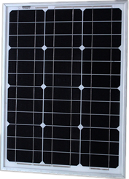
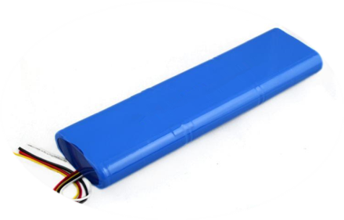
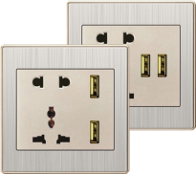
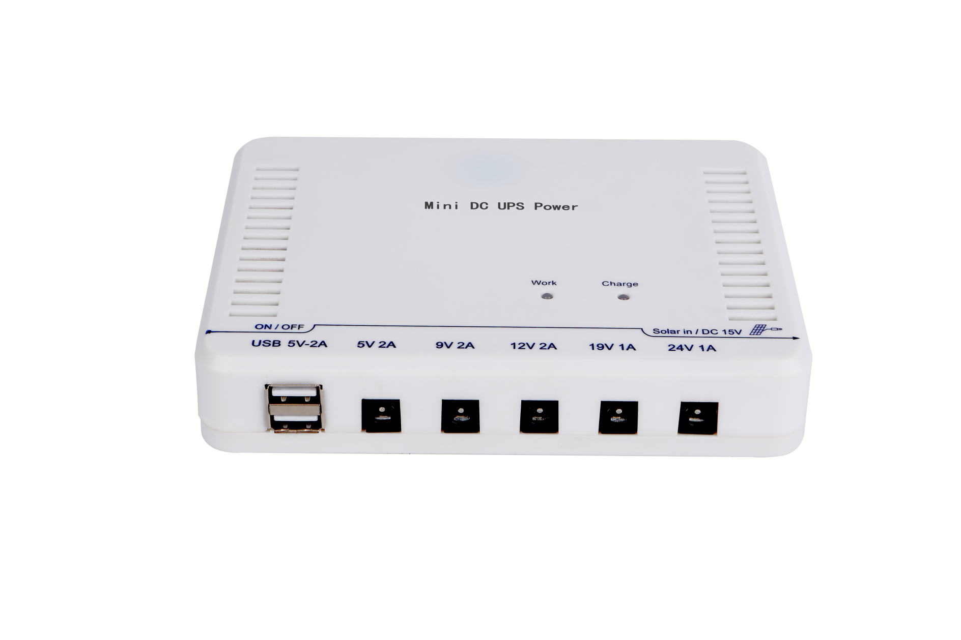
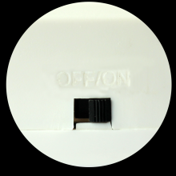
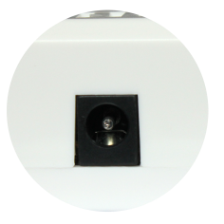
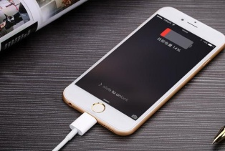
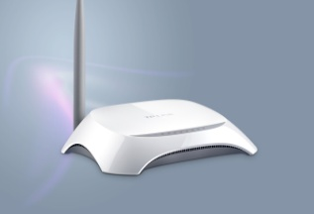
Mini dc ups
MANUAL SWITCH
Built-in 12,000mAh
18650 Li-ion Battery
AC & SOLAR
INPUT
DC 5V OUTPUT
DC 5/9V OUTPUT
DC 12V OUTPUT
DC 19V OUTPUT
DC 24V OUTPUT
Application:
Laptop ...
Application:
Mobile, PC,
Modem ...
Application:
Router, Light,
Fans ...
Application:
Monitoring, Camping ...
Application:
Laptop ...
Application:
Entrance Guard, Security and Protection ...

Slide 2
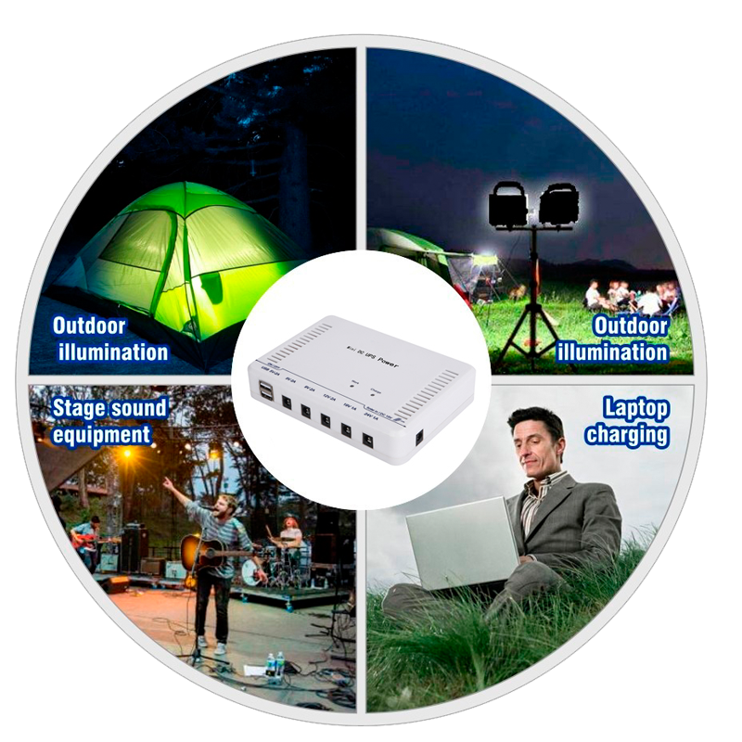
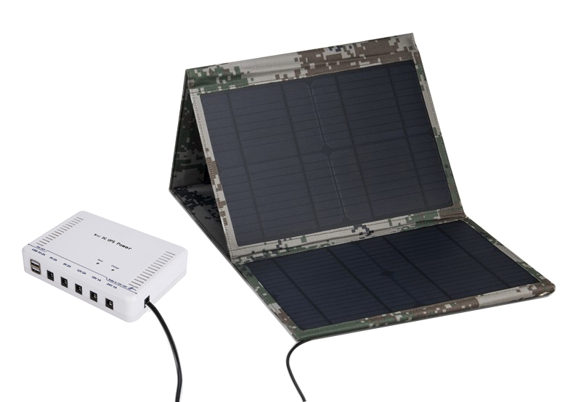
Colorful outdoor life
Specifications:
Model | NCTS-NUDC6000 |  | NCTS-NUDC12000
Capacity | 6000mAh |  | 12000mAh
Battery type | 18650 rechargeable lithium ion battery
Charging Current | 1A | Discharging Current |  | 2A
System Voltage | 11.1V | Power Loss |  | 200μAh
Solar input voltage | DC 15V
Over Voltage Protection | 12.6V | Over Charging Protection |  | 12.5V
Operation Temperature | -10℃-+50℃
Circuit Protection | Overcharging protected by the system |  | Over load & Short circuit protected by battery
Dimension: | 159*112*32mm
Unit Weight | 0.5kgs |  | 1kgs
Main features · Output interface: 2 x USB 5v/1a, Jack interface 5V-2A , 9V/ 2A, 12V /2A, 19V /1A, 24V /1A · Fashion white and ultrathin body design . · Portable design , it can be carried in 1 hand , best partner of outdoor travelers . · Solar charging function will power your life infinitely . · Powered by AC or Solar power , charging any where. · 7 different interfaces , suitable for most electronic products around the life . · Multi-function , only one UPS can solve all power requires .
Applications It suitable for : Mobile phone , I phone ,Tablet , Laptop, PS2/3/4, Modem, Router, Entrance Guard, IP Camera, Lights

