Slide 3
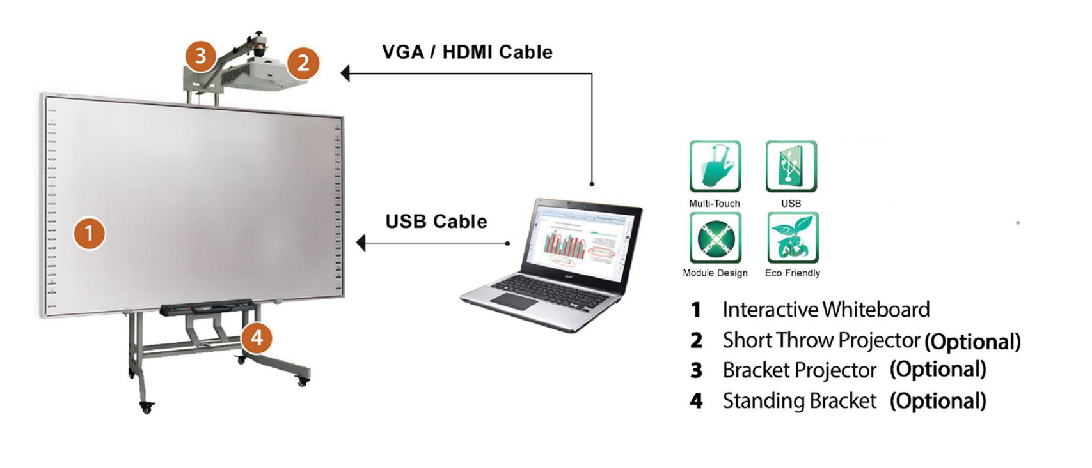
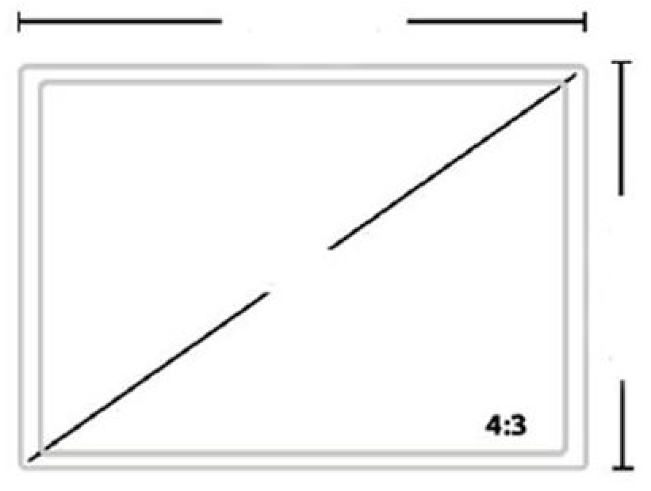
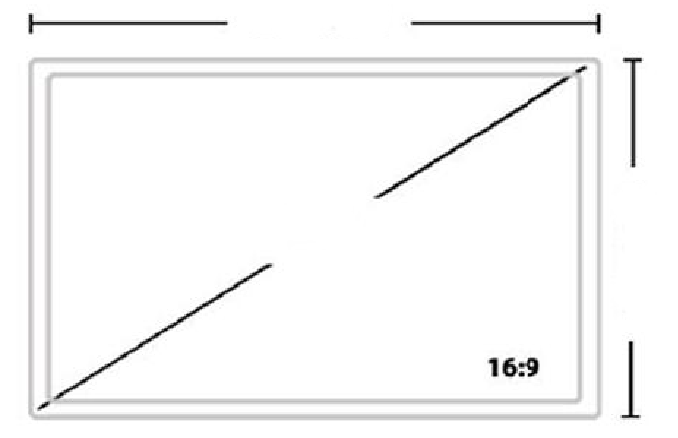
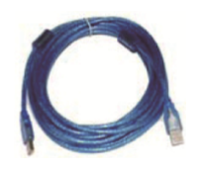
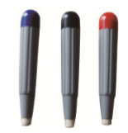
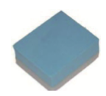
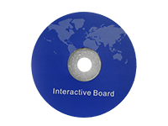
Sizes
1775mm
NCTS-IB86 86”
INTERACTIVEWHITEBOARD
Total Area Size:1775x1280mm Projection Size:1622x1216mm
Total Area Diagonal Size:86”
Aspect Ratio:4:3
Surface:Nano Surface
86”
1280mm
2010mm
NCTS-IB90 90”
INTERACTIVEWHITEBOARD
Total Area Size: 2010 x1100 mm Projection Size:1842x1036mm
Total Area Diagonal Size:90”
Aspect Ratio:16:9
Surface:Nano Surface
90”
1100mm
2151mm
NCTS-IP95 95”
INTERACTIVEWHITEBOARD
Total Area Size: 2071 x1251 mm Projection Size:1899x1187mm
Total Area Diagonal Size:95”
Aspect Ratio:16:10
Surface:Nano Surface
95”
1190mm
16：10
Accessories
X 4
Wall mounts USB cable Pens Pointer Eraser iPen tray Software CD

Slide 4
TECHNICAL SPECIFICATION
Hardware Special Features | Gesture recognition
Touch Technology | Infrared
Touch Point | 10 touch
Resolution: | 32767 x 32767
Cursor Speed | 180 dot /s
Effect Touch Object Size | >8mm
Touch Method | Finger or Pen
Positioning Accuracy | <2mm
Connecting Port | USB 2.0
Operating System | Windows 2000, Windows XP, Windows Vista, Windows 7, Windows 8.1,Windows 10, Linux, Mac, Android
Power Supply | USB power supply DC 4.6V- 5.0V <1W ( 100mA at 5V)
Working Condition | Indoor or Outdoor
Storage | Temperature: -30°C~60°C Humidity: 0%~95%
Operation | Temperature: -10°C~45°C Humidity: 10%~90%
Installation | Wall mounted, cabinets, mobile stand (optional)
TECHNICAL SPECIFICATIONS
PHYSICAL SPECIFICATION
Model | NCTS-IB86 | NCTS-IB90 | NCTS-IB95
Overall Size(mm) | 1775x1280 | 2010 x1100 | 2071 x1251
Projection Size(mm) | 1622x1216 | 1842x1036 | 1899 x1187
Overall Diagonal | 86” | 90” | 95”
Aspect Ratio | 4:3 | 16:9 | 16:10
Board Weight(kg) | 18 | 20 | 25
Gross Weight (kg) | 25 | 28 | 32
Product Dimension(mm) | 1775x1280 x 37.5 | 2010 x1100 x37.5 | 2071 x1251 x37.5
Packed Size(mm) | 1845x1380 x80 | 2100 x1190 x80 | 2160 x1340 x80

